Slide 1
IBM Data Science Certification program
Applied Data Science Capstone

Slide 2
1. What is Data Science ?
2. Open Source tools for Data Science
3. Data Science Methodology
4. Python for Data Science and AI
5. Databases and SQL for Data Science
6. Data Analysis with Python
7. Data visualization with Python
8. Machine Learning with Python
9. Applied Data Science Capstone
Key Concepts discussed in this presentation
Define a problem for my capstone project.
Discuss the data that I will use to solve the problem.
Using FourSquare API we will find all venues for each neighborhood.
Visualize the Ranking of neighborhoods using folium library(python).

Slide 3
Data to be used
1. Data source : https://cocl.us/new_york_dataset
Description - his data set contains the required information. And we will use this data set to explore various neighborhoods of new york city. Indian restaurants in each neighborhood of New York city.
2. Data source : Foursquare API
Description : By using this API we will get all the venues in each neighborhood. We can filter these venues to get only Indian Restaurants.
3. Data source : https://data.cityofnewyork.us/City-Government/Borough-Boundaries/tqmj-j8zm
Description : By using this geo space data we will get the New York Borough boundaries that will help us to visualize choropleth map.

Slide 4
Approach
Collect the New York city data from https://cocl.us/new_york_dataset
Using FourSquare API we will find all venues for each neighborhood.
Filter out all venues that are Indian Restaurants.
Find rating , tips and like count for each Indian Restaurants using FourSquare API.
Using rating for each restaurant , we will sort that data.

Slide 5
Libraries to be used
pandas and numpy for handling data.
request module for using FourSquare API.
geopy to get co-ordinates of City of New York.

Slide 6
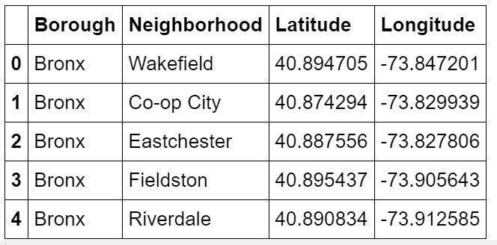
Step 1
Load data from https://cocl.us/new_york_dataset
in pandas Dataframe.
Getting Latitude and Longitude for each address geopy library.
As result –
We have 306 rows like this.

Slide 7
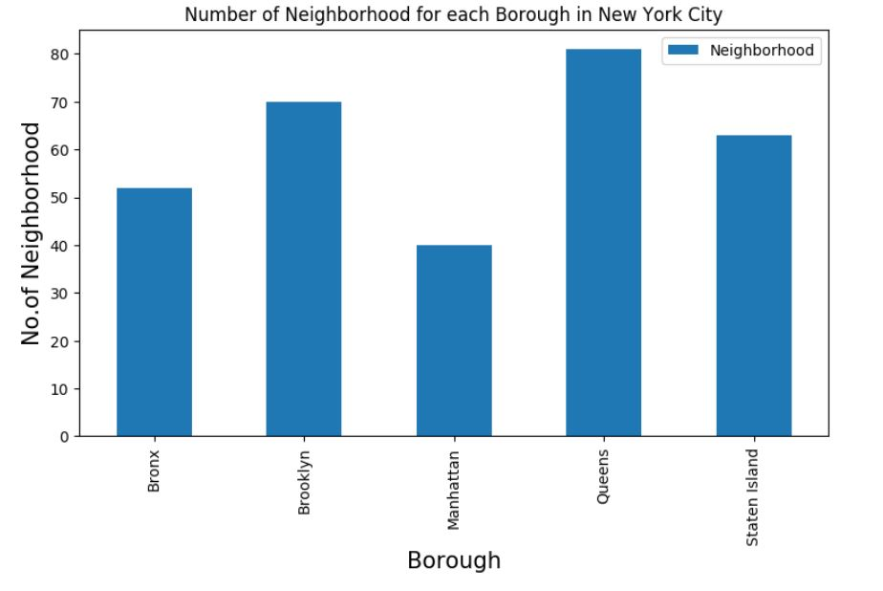
Number of neighborhoods in each Borough

Slide 8
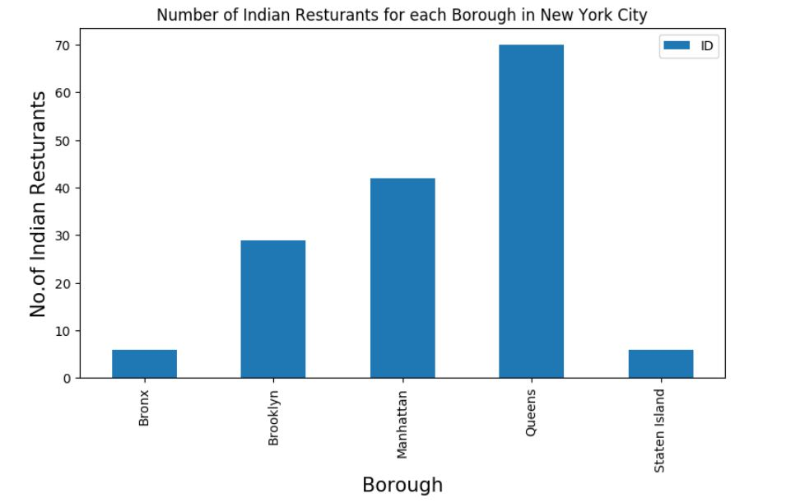
Step 2
Filter out which Borough and Neighborhood have maximum number of Indian Restaurants using FourSquare API.
Result – Queens has maximum number of Restaurants

Slide 9
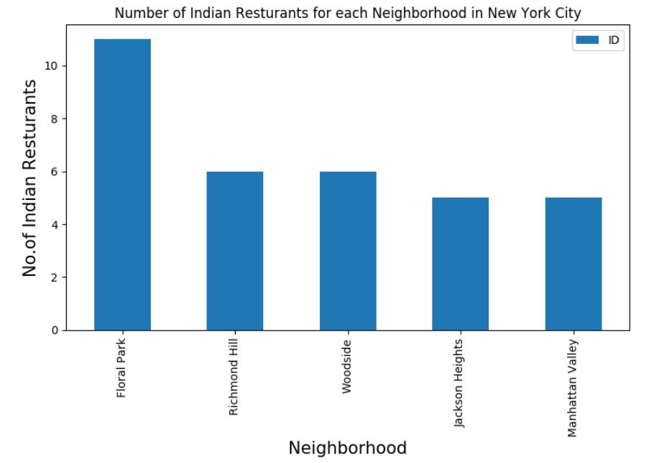
Step 2
Filter out which Borough and Neighborhood have maximum number of Indian Restaurants using FourSquare API.
Result – Floral Park has maximum number of Restaurants

Slide 10
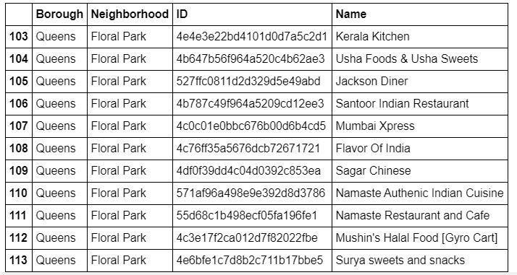
List of Restaurants in Floral Park

Slide 11
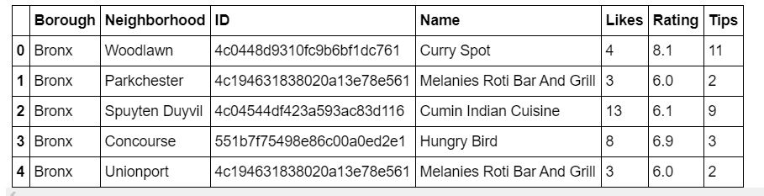
Step 3
Get likes, ratings, tips on each of Indian Restaurant using FourSquare API

Slide 12
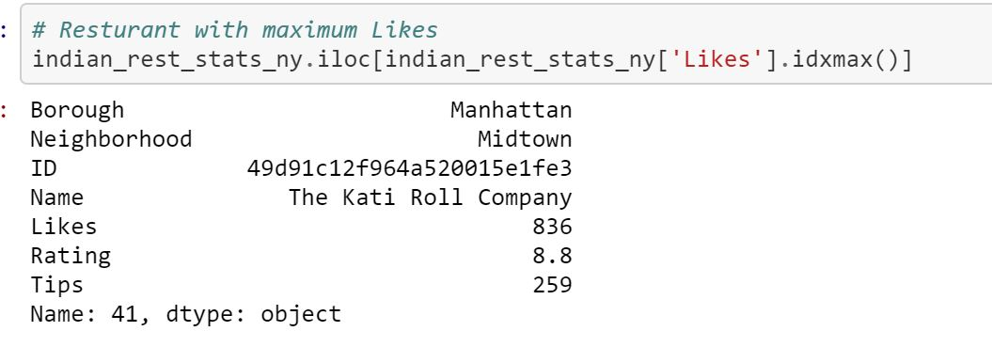
Result
Restaurant with maximum like

Slide 13
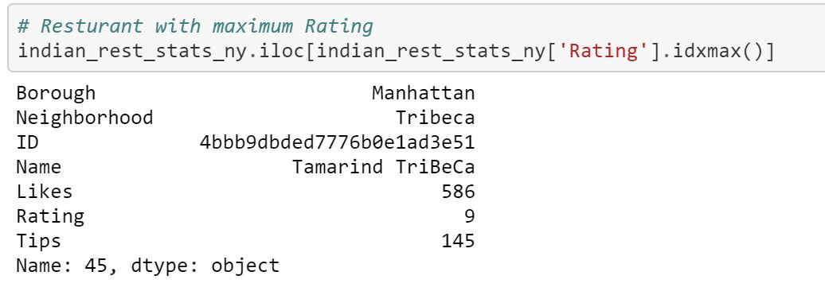
Result
Restaurant having maximum Rating

Slide 14
Conclusion
Astoria(Queens), Blissville(Queens), Civic Center(Manhattan) are some of the best neighborhoods for indian cuisine.
Manhattan have potential Indian Resturant Market
Staten Island ranks last in average rating of Indian Restaurants.
Manhattan is the best place to stay if you prefer Indian Cuisine.

Slide 15

The accuracy of data depends purely depends on the data provided by FourSquare
Limitation

Slide 16

Thank you
Any queries ?

